Slide 1
Advancement

Slide 2
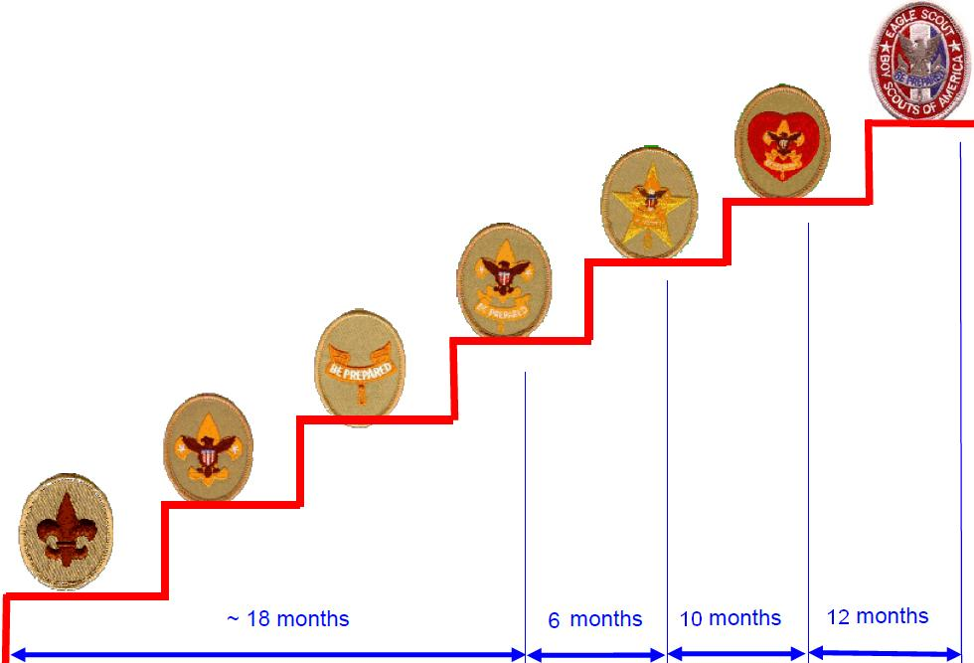
Recognition and Advancement
Rank Advancement

Slide 3
Rank Requirements - Summarized
Scout – Introductory skills and basic scout knowledge
Tenderfoot – skill based
Second Class – skill based
First Class – skill based
Star – Merit badges, Leadership, service hours
Life - Merit badges, Leadership, service hours
Eagle - Merit badges, Leadership, Service Project to benefit the community, Eagle Board of Review, National approval

Slide 4
Tools
Each scout can track their requirements in the back on the Scout handbook
They can also use Scoutbook (online app), which the adult leaders update.
https://scoutbook.scouting.org/
Parents are encouraged to register for Scoutbook and then give their scout access to it; adult leaders cannot grant scouts access.
If they are going to be glued to their phones, make it useful
Scouts can log when they think a requirement has been completed, and adults can sign it off.

Slide 5
Merit Badges - 138
https://www.scouting.org/skills/merit-badges/
https://scoutsmarts.com/about/ << Great resource
Eagle Scout takes a total of 21 merit badges.
14 Eagle required
7 Elective
You can earn eagle palms for every 5 merit badges beyond 21.

Slide 6
Best Order to earn the badges
https://scoutsmarts.com/eagle-merit-badge-difficulty-rankings/

Slide 7
How to earn merit badges
Summer Camp – Troop function
Themed camping trips (Camp-o-ree) – Troop function
Special opportunities – ex – factory tour - Individual
Planned troop meetings with merit badge focus – Troop function if youth decide to do it
Merit Badge Challenge - Individual
https://danbeard.org/merit-badge-challenge/
Find a Merit Badge Counselor - Individual
Troop function = scout will be signed up as part of troop program
Individual = Scout and scout parent must make initiative to sign the scout up and transport; communicate to troop leader upon completion

Slide 8
Finding a Merit Badge Counselor
Scouts are encouraged to reach out to merit badge counselors to work on merit badges at a faster pace
Pick a merit badge, look up requirements
Get scoutmaster approval
Get another person to commit to do it with you
Call the merit badge counselor
Set up time to start working through requirements
Show your work
https://danbeard.org/find-a-merit-badge-counselor/
https://www.scouting.org/skills/merit-badges/

